Slide 1

Career resources for Bioinformatics
Career Development Session
Inimary Toby, PhD

Slide 2
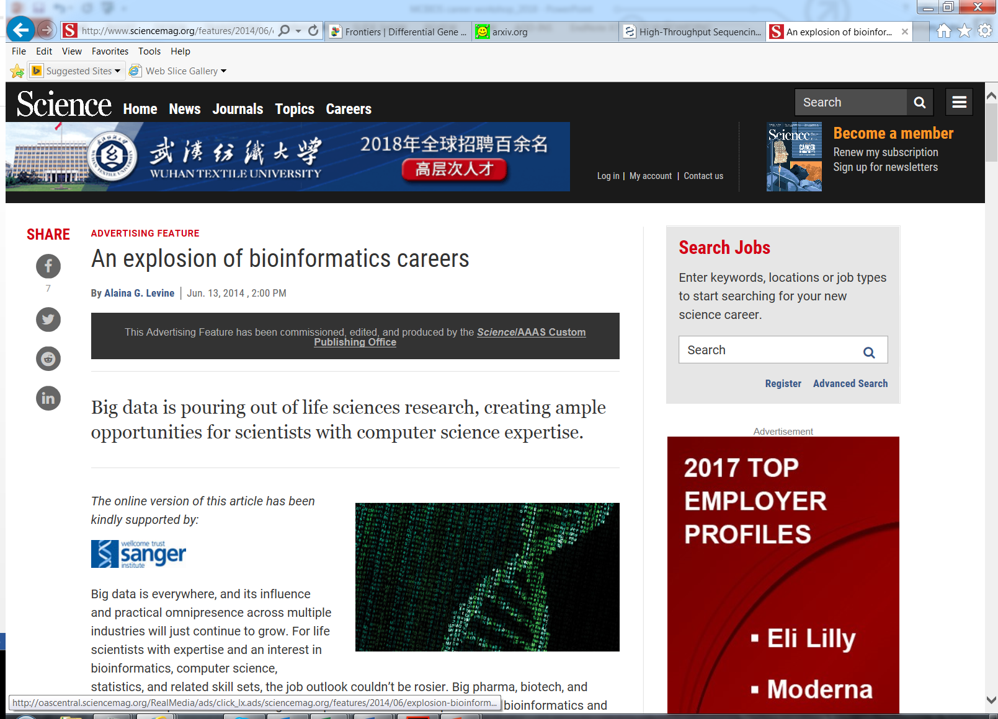
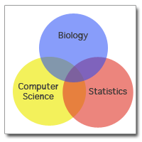
Examining trends in Bioinformatics
AAAS, 2014

Slide 3
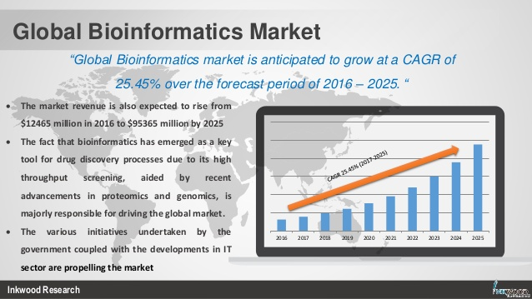
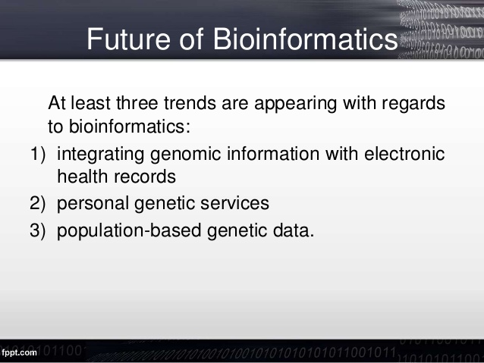
Trends in Bioinformatics
https://www.slideshare.net/sherrythomas13/bioinformatics-market-global-industry-trends-analysis-revenue-report-20172025
https://www.slideshare.net/SealingOnlyYours/bioinformatics-33211564

Slide 4
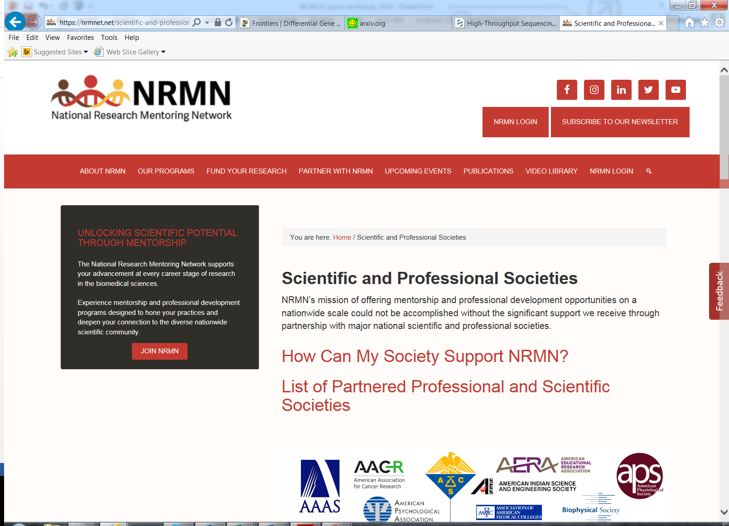
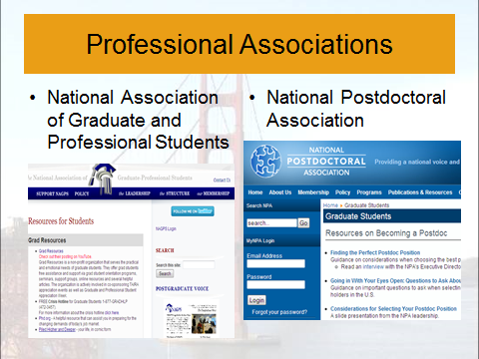
Professional Affiliations: leveraging multiple avenues

Slide 5
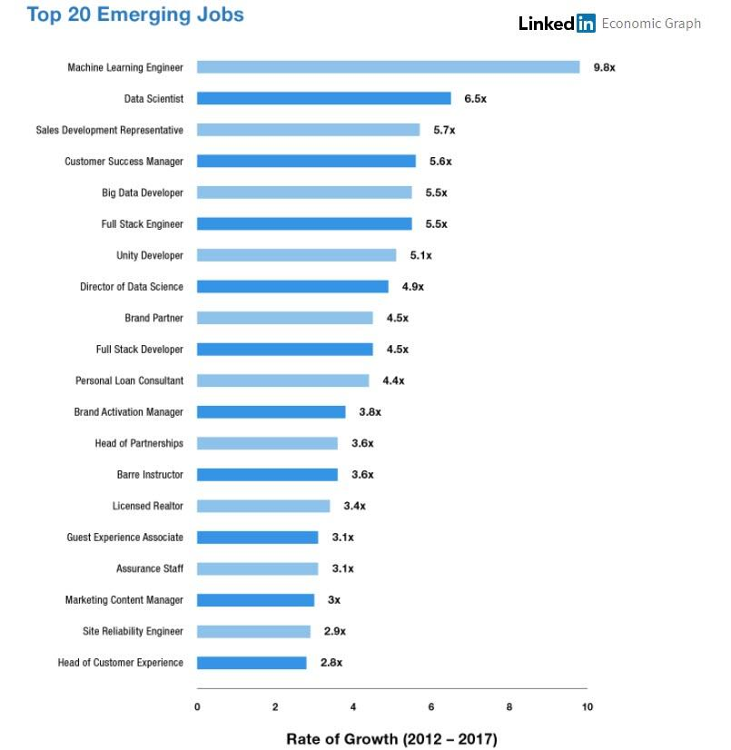

Slide 6
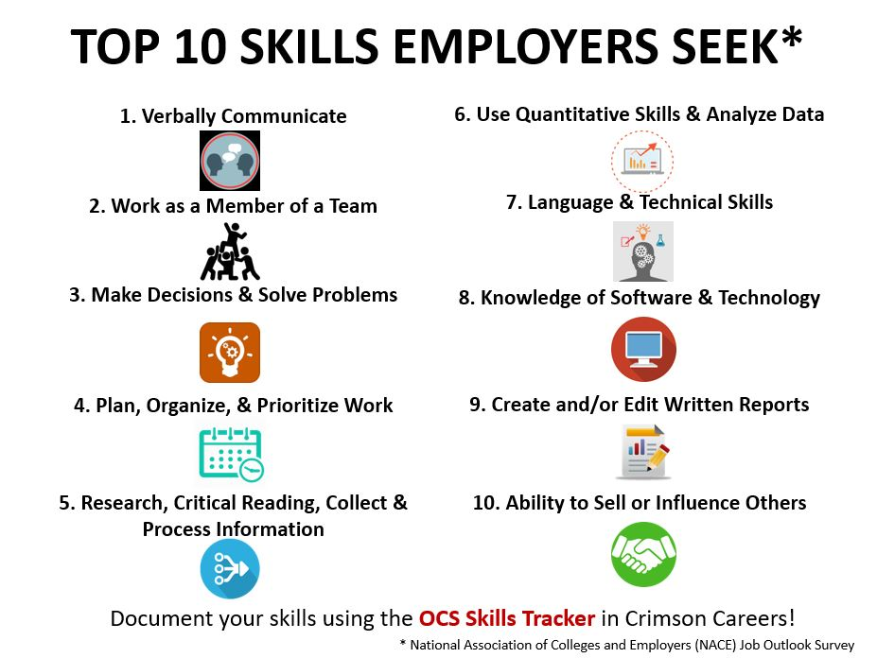

Slide 7
Knowledge about open source data

Slide 8
Job Search Resources

Slide 9
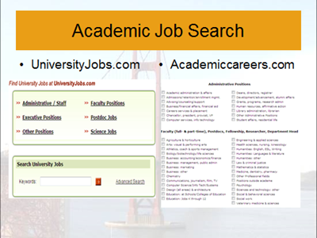
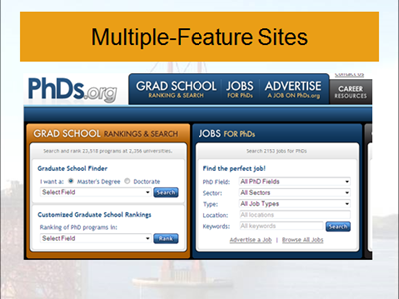
Job searches within Academia

Slide 10
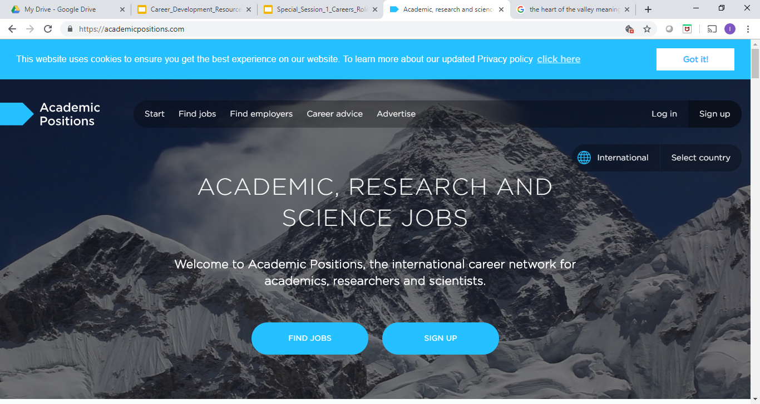

Slide 11
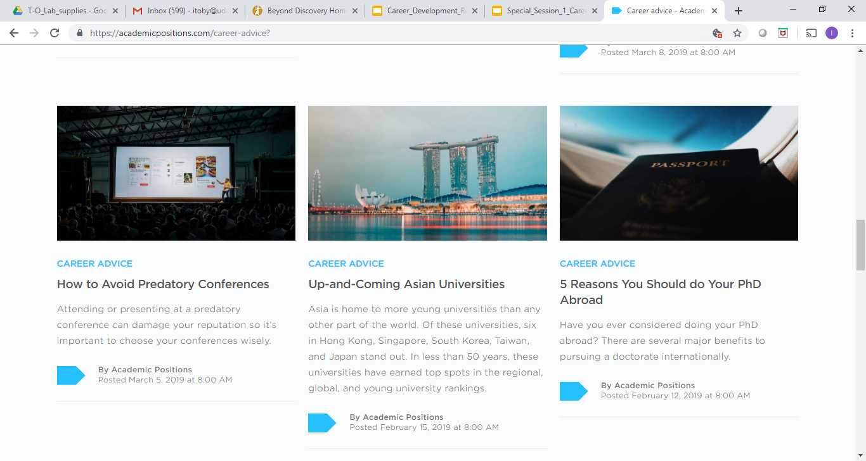

Slide 12
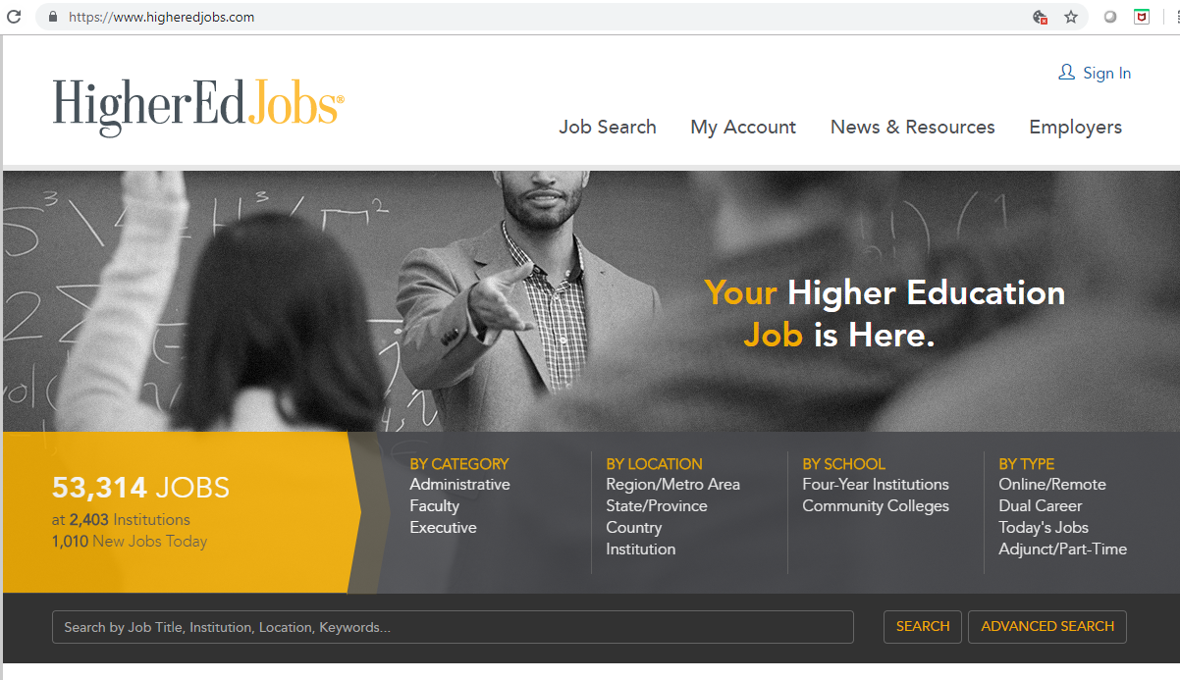
HigherEd jobs

